Slide 1
Implementation support
programming tools
  levels of services for programmers
windowing systems
  core support for separate and simultaneous user-system activity
programming the application and control of dialogue
interaction toolkits
  bring programming closer to level of user perception
user interface management systems
  controls relationship between presentation and functionality

Slide 2
Introduction
How does HCI affect of the programmer?
Advances in coding have elevated programming
hardware specific → interaction-technique specific.
Layers of development tools
• windowing systems
• interaction toolkits
• user interface management systems

Slide 3
Elements of windowing systems
Device independence
programming the abstract terminal device drivers
image models for output and (partially) input
• pixels
• Graphical Kernel System (GKS)
• Programmers' Hierarchical Interface to Graphics (PHIGS)
• PostScript
Resource sharing
achieving simultaneity of user tasks
window system supports independent processes
isolation of individual applications

Slide 4
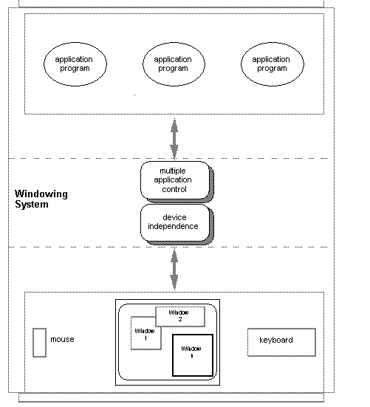
The roles of a windowing system

Slide 5
Architectures of windowing systems
3 possible software architectures
all assume device driver is separate
differ in how multiple application management is implemented
1. each application manages all processes
everyone worries about synchronization
reduces portability of applications
2. management role within kernel of operating system
applications tied to operating system
3. management role as separate application
maximum portability

Slide 6
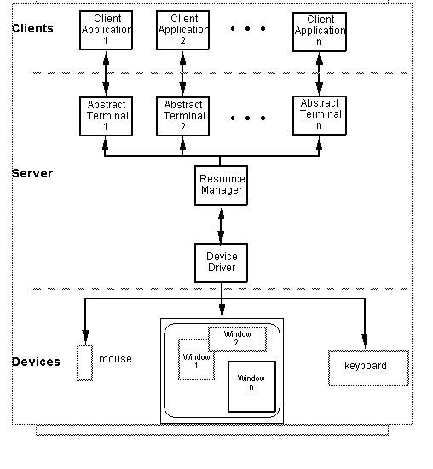
The client-server architecture

Slide 7
The X Window System architecture

Slide 8
The X Window System architecture (cont’d)
pixel imaging model with some pointing mechanism
X protocol defines server-client communication
separate window manager client
enforces policies for input/output:
• how to change input focus
• tiled vs. overlapping windows
• inter-client data transfer

Slide 9
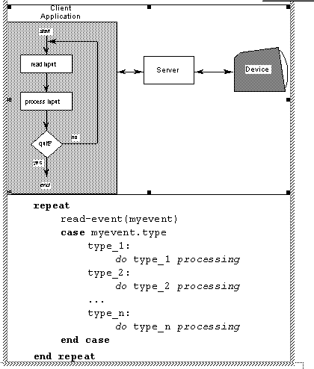
Programming the application - 1
read-evaluation loop

Slide 10
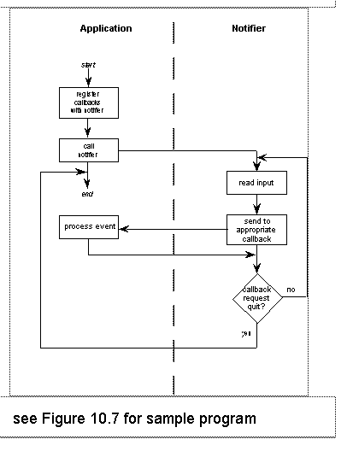
Programming the application - 2
notification-based

Slide 11
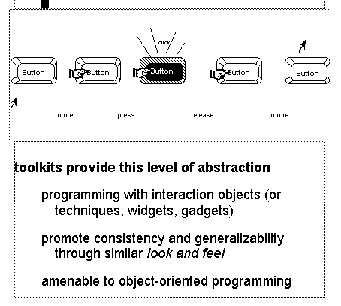
Using toolkits
Interaction objects
input and output intrinsically linked

Slide 12
User Interface Management Systems
UIMS add another level above toolkits
toolkits too difficult for non-programmers
non-UIMS alternatives:
UI development system (UIDS)
UI development environment (UIDE)
UIMS as a conceptual architecture
separation between application semantics and presentation
improves:
portability, reusability
multiple interfaces, customizability
identifies roles (e.g., Seeheim):
presentation component
dialogue control
application interface model

Slide 13
Implementation of UIMS
Techniques for dialogue controller
• menu networks • state transition diagrams
• grammar notations • event languages
• declarative languages • constraints
• graphical specification
The drift of dialogue control
internal control
(e.g., read-evaluation loop)
external control
(independent of application semantics or presentation)
presentation control
(e.g., graphical specification)

Slide 14
Summary
Levels of programming support tools
Windowing systems
device independence
multiple tasks
Paradigms for programming the application
read-evaluation loop
notification-based
Toolkits
programming interaction objects
UIMS
conceptual architectures for separation
techniques for expressing dialogue

